Slide 1
Employee data analysis using excel
STUDENT NAME : BOOBALAN.P
REGISTER NO : 312204015
User name : 088BFF4B75DE08C89DD4ECD6C7EE2511
DEPARTMENT : UG AND BACHILOR OF COMMERCE
COLLEGE : SRI RAM COLLEGE OF ARTS AND
SCIENCE

Slide 2
Project title
Employee Performance Analysis
Using Excel

Slide 3
AGENDA
Problem Statement
Project Overview
End users
Our Solution and Proposition
Dataset Description
Modelling Approach
Results and Discussion
Conclusion

Slide 4
PROBLEM STATEMENT
Job-Specific Skills: Evaluate how well employees perform the core tasks of their job. This includes technical skills, knowledge, and competency in their specific role.
Quality of Work: Assess the accuracy, thoroughness, and effectiveness of the work produced. High-quality work usually meets or exceeds standards and contributes to overall success.
Productivity: Measure how efficiently employees complete their tasks. This includes their ability to manage time, meet deadlines, and handle workload effectively.
Attendance and Punctuality: Consider the reliability of employees in terms of their attendance and punctuality, as these factors can impact overall team performance.

Slide 5
PROJECT OVERVIEW
Analysis of data using employee database for their performance using different matrix
Employee performance refers to how effectively and efficiently an employee executes their job responsibilities and contributes to the organization's goals. It encompasses various aspects of an employee's work, including the quality, quantity, and impact of their output.

Slide 6
DATASET DESCRIPTION
Employee data set – Kaggle
26features
Feature - 9 feature
Employee id
Gender - male, female
Performance
Business unit
Name
Rating - numerical

Slide 7
THE “WOW” IN OUR SOLUTION
Exceptional Problem-Solving Skills: Employees who can tackle complex issues creatively and effectively often make a significant impact. Look for individuals who proactively address challenges and come up with innovative solutions.
Outstanding Communication: Employees who excel in both verbal and written communication can drive projects forward, facilitate better team collaboration, and improve client relations. Their ability to articulate ideas clearly and listen actively can be game-changing.
Leadership and Initiative: Those who go beyond their job description by taking on leadership roles, mentoring others, or spearheading new initiatives demonstrate a high level of engagement and commitment.
Continuous Learning and Improvement: Employees who actively seek out opportunities for growth, whether through additional training, certifications, or staying current with industry trends, show a commitment to both their personal development and the company's success.

Slide 8
MODELLING
Data collection - books and google
Data cleaning - Define Data Requirements, Gather Data
Techniques - Regular Performance Reviews, Goal Setting and Management
Pivot table - to analyze employee performance data can provide valuable insights and help you summarize, analyze, and present performance information effectively

Slide 9


results

Slide 10
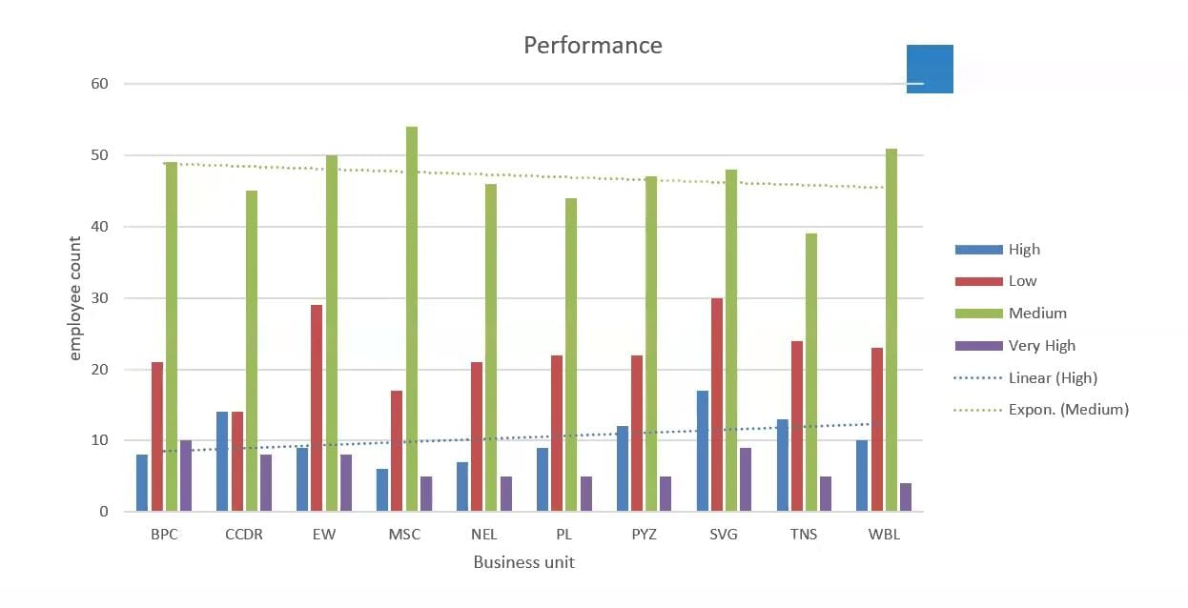
conclusion
Employee a consistently exceeded sales targets and demonstrated explanation costumer satisfaction skills . Employee B showed improvement in productivity but needs to work on customer satisfaction . Employee C stuggled with sales performance but demonstrated strengths in productivity .
Notes:
Based on the Excel analysis of employee performers consistenly exceeded targets ,while some employees showed areas for improvement ,particulary in [specific tasks or metrics].to enhance overall performance ,targeted training and support are recommended for underperforming areas,along with recognition and reward for high acheivers. Continued monitoring and periodic reviews will help sustain and improve performance levels. Based on the Excel analysis of employee performers consistenly exceeded targets ,while some employees showed areas for improvement ,particulary in [specific tasks or metrics].to enhance overall performance ,targeted training and support are recommended for underperforming areas,along with recognition and reward for high acheivers. Continued monitoring and periodic reviews will help sustain and improve performance levels.
Based on the Excel analysis of employee performers consistenly exceeded targets ,while some employees showed areas for improvement ,particulary in [specific tasks or metrics].to enhance overall performance ,targeted training and support are recommended for underperforming areas,along with recognition and reward for high acheivers. Continued monitoring and periodic reviews will help sustain and improve performance levels.
Based on the Excel analysis of employee performers consistenly exceeded targets ,while some employees showed areas for improvement ,particulary in [specific tasks or metrics].to enhance overall performance ,targeted training and support are recommended for underperforming areas,along with recognition and reward for high acheivers. Continued monitoring and periodic reviews will help sustain and improve performance levels.
Based on the Excel analysis of employee performers consistenly exceeded targets ,while some employees showed areas for improvement ,particulary in [specific tasks or metrics].to enhance overall performance ,targeted training and support are recommended for underperforming areas,along with recognition and reward for high acheivers. Continued monitoring and periodic reviews will help sustain and improve performance levels.
Based on the Excel analysis of employee performers consistenly exceeded targets ,while some employees showed areas for improvement ,particulary in [specific tasks or metrics].to enhance overall performance ,targeted training and support are recommended for underperforming areas,along with recognition and reward for high acheivers. Continued monitoring and periodic reviews will help sustain and improve performance levels.
Based on the Excel analysis of employee performers consistenly exceeded targets ,while some employees showed areas for improvement ,particulary in [specific tasks or metrics].to enhance overall performance ,targeted training and support are recommended for underperforming areas,along with recognition and reward for high acheivers. Continued monitoring and periodic reviews will help sustain and improve performance levels.
Based on the Excel analysis of employee performers consistenly exceeded targets ,while some employees showed areas for improvement ,particulary in [specific tasks or metrics].to enhance overall performance ,targeted training and support are recommended for underperforming areas,along with recognition and reward for high acheivers. Continued monitoring and periodic reviews will help sustain and improve performance levels.
Based on the Excel analysis of employee performers consistenly exceeded targets ,while some employees showed areas for improvement ,particulary in [specific tasks or metrics].to enhance overall performance ,targeted training and support are recommended for underperforming areas,along with recognition and reward for high acheivers. Continued monitoring and periodic reviews will help sustain and improve performance levels.
Based on the Excel analysis of employee performers consistenly exceeded targets ,while some employees showed areas for improvement ,particulary in [specific tasks or metrics].to enhance overall performance ,targeted training and support are recommended for underperforming areas,along with recognition and reward for high acheivers. Continued monitoring and periodic reviews will help sustain and improve performance levels.
Based on the Excel analysis of employee performers consistenly exceeded targets ,while some employees showed areas for improvement ,particulary in [specific tasks or metrics].to enhance overall performance ,targeted training and support are recommended for underperforming areas,along with recognition and reward for high acheivers. Continued monitoring and periodic reviews will help sustain and improve performance levels.
Based on the Excel analysis of employee performers consistenly exceeded targets ,while some employees showed areas for improvement ,particulary in [specific tasks or metrics].to enhance overall performance ,targeted training and support are recommended for underperforming areas,along with recognition and reward for high acheivers. Continued monitoring and periodic reviews will help sustain and improve performance levels.
Based on the Excel analysis of employee performers consistenly exceeded targets ,while some employees showed areas for improvement ,particulary in [specific tasks or metrics].to enhance overall performance ,targeted training and support are recommended for underperforming areas,along with recognition and reward for high acheivers. Continued monitoring and periodic reviews will help sustain and improve performance levels.
Based on the Excel analysis of employee performers consistenly exceeded targets ,while some employees showed areas for improvement ,particulary in [specific tasks or metrics].to enhance overall performance ,targeted training and support are recommended for underperforming areas,along with recognition and reward for high acheivers. Continued monitoring and periodic reviews will help sustain and improve performance levels.
Based on the Excel analysis of employee performers consistenly exceeded targets ,while some employees showed areas for improvement ,particulary in [specific tasks or metrics].to enhance overall performance ,targeted training and support are recommended for underperforming areas,along with recognition and reward for high acheivers. Continued monitoring and periodic reviews will help sustain and improve performance levels.
Based on the Excel analysis of employee performers consistenly exceeded targets ,while some employees showed areas for improvement ,particulary in [specific tasks or metrics].to enhance overall performance ,targeted training and support are recommended for underperforming areas,along with recognition and reward for high acheivers. Continued monitoring and periodic reviews will help sustain and improve performance levels.
Based on the Excel analysis of employee performers consistenly exceeded targets ,while some employees showed areas for improvement ,particulary in [specific tasks or metrics].to enhance overall performance ,targeted training and support are recommended for underperforming areas,along with recognition and reward for high acheivers. Continued monitoring and periodic reviews will help sustain and improve performance levels.
Based on the Excel analysis of employee performers consistenly exceeded targets ,while some employees showed areas for improvement ,particulary in [specific tasks or metrics].to enhance overall performance ,targeted training and support are recommended for underperforming areas,along with recognition and reward for high acheivers. Continued monitoring and periodic reviews will help sustain and improve performance levels.
Based on the Excel analysis of employee performers consistenly exceeded targets ,while some employees showed areas for improvement ,particulary in [specific tasks or metrics].to enhance overall performance ,targeted training and support are recommended for underperforming areas,along with recognition and reward for high acheivers. Continued monitoring and periodic reviews will help sustain and improve performance levels.
Based on the Excel analysis of employee performers consistenly exceeded targets ,while some employees showed areas for improvement ,particulary in [specific tasks or metrics].to enhance overall performance ,targeted training and support are recommended for underperforming areas,along with recognition and reward for high acheivers. Continued monitoring and periodic reviews will help sustain and improve performance levels.
Based on the Excel analysis of employee performers consistenly exceeded targets ,while some employees showed areas for improvement ,particulary in [specific tasks or metrics].to enhance overall performance ,targeted training and support are recommended for underperforming areas,along with recognition and reward for high acheivers. Continued monitoring and periodic reviews will help sustain and improve performance levels.
Based on the Excel analysis of employee performers consistenly exceeded targets ,while some employees showed areas for improvement ,particulary in [specific tasks or metrics].to enhance overall performance ,targeted training and support are recommended for underperforming areas,along with recognition and reward for high acheivers. Continued monitoring and periodic reviews will help sustain and improve performance levels.
Based on the Excel analysis of employee performers consistenly exceeded targets ,while some employees showed areas for improvement ,particulary in [specific tasks or metrics].to enhance overall performance ,targeted training and support are recommended for underperforming areas,along with recognition and reward for high acheivers. Continued monitoring and periodic reviews will help sustain and improve performance levels.
Based on the Excel analysis of employee performers consistenly exceeded targets ,while some employees showed areas for improvement ,particulary in [specific tasks or metrics].to enhance overall performance ,targeted training and support are recommended for underperforming areas,along with recognition and reward for high acheivers. Continued monitoring and periodic reviews will help sustain and improve performance levels.
Based on the Excel analysis of employee performers consistenly exceeded targets ,while some employees showed areas for improvement ,particulary in [specific tasks or metrics].to enhance overall performance ,targeted training and support are recommended for underperforming areas,along with recognition and reward for high acheivers. Continued monitoring and periodic reviews will help sustain and improve performance levels.
Based on the Excel analysis of employee performers consistenly exceeded targets ,while some employees showed areas for improvement ,particulary in [specific tasks or metrics].to enhance overall performance ,targeted training and support are recommended for underperforming areas,along with recognition and reward for high acheivers. Continued monitoring and periodic reviews will help sustain and improve performance levels.
Based on the Excel analysis of employee performers consistenly exceeded targets ,while some employees showed areas for improvement ,particulary in [specific tasks or metrics].to enhance overall performance ,targeted training and support are recommended for underperforming areas,along with recognition and reward for high acheivers. Continued monitoring and periodic reviews will help sustain and improve performance levels.
Based on the Excel analysis of employee performers consistenly exceeded targets ,while some employees showed areas for improvement ,particulary in [specific tasks or metrics].to enhance overall performance ,targeted training and support are recommended for underperforming areas,along with recognition and reward for high acheivers. Continued monitoring and periodic reviews will help sustain and improve performance levels.
Based on the Excel analysis of employee performers consistenly exceeded targets ,while some employees showed areas for improvement ,particulary in [specific tasks or metrics].to enhance overall performance ,targeted training and support are recommended for underperforming areas,along with recognition and reward for high acheivers. Continued monitoring and periodic reviews will help sustain and improve performance levels.
Based on the Excel analysis of employee performers consistenly exceeded targets ,while some employees showed areas for improvement ,particulary in [specific tasks or metrics].to enhance overall performance ,targeted training and support are recommended for underperforming areas,along with recognition and reward for high acheivers. Continued monitoring and periodic reviews will help sustain and improve performance levels.
Based on the Excel analysis of employee performers consistenly exceeded targets ,while some employees showed areas for improvement ,particulary in [specific tasks or metrics].to enhance overall performance ,targeted training and support are recommended for underperforming areas,along with recognition and reward for high acheivers. Continued monitoring and periodic reviews will help sustain and improve performance levels.
Based on the Excel analysis of employee performers consistenly exceeded targets ,while some employees showed areas for improvement ,particulary in [specific tasks or metrics].to enhance overall performance ,targeted training and support are recommended for underperforming areas,along with recognition and reward for high acheivers. Continued monitoring and periodic reviews will help sustain and improve performance levels.
Based on the Excel analysis of employee performers consistenly exceeded targets ,while some employees showed areas for improvement ,particulary in [specific tasks or metrics].to enhance overall performance ,targeted training and support are recommended for underperforming areas,along with recognition and reward for high acheivers. Continued monitoring and periodic reviews will help sustain and improve performance levels.
Based on the Excel analysis of employee performers consistenly exceeded targets ,while some employees showed areas for improvement ,particulary in [specific tasks or metrics].to enhance overall performance ,targeted training and support are recommended for underperforming areas,along with recognition and reward for high acheivers. Continued monitoring and periodic reviews will help sustain and improve performance levels.

